Slide 1
Smart Analysis of Medical Report
Team Members
1.Sakthivel.S (211616104201)
2.Rohit.E (211616104194)
3.ShivKarthee.J (211616104215)
Guide:
Mrs.Cibi
Assistant Professor(SS)

Slide 2
Introduction
Nowadays, many techniques and products are developed for the paperless office to protect our environment, but papery documents are still common in public services like medical laboratory reports, especially in developing countries
For effective medical care and accurate diagnosis, the reports are required to be up to date and complete but the paper files are neither portable nor convenient for long-term preservation.
To solve this problem, we present a document images processing system that can extract information from medical laboratory reports.
This work is mainly related to Optical Character Recognition (OCR), which has a long history in computer vision community.

Slide 3
Objective
We know that there are many patients in a hospital. From the medical scan reports, medical summaries are written by duty doctors or head nurses. Likewise, this is done for many patients.
After a period of some days (in future) ,if the same doctor, or a different doctor, needs to diagnose or needs to know the medical condition of a particular patient, he/she has to read the whole summary. This is time consuming.

Slide 4
Abstract
Medical laboratory report is one kind of essential document for health care professionals in patient assessment, diagnosis, and long-term monitoring. Compared with paper files, electronic records are convenient for keeping up to date, complete, and accurate, which is already common in modern medical system.
In this paper, we present a document image processing system used for extracting information from medical laboratory reports. Given an image of medical laboratory report, its table areas and texts are firstly segmented following a top-down pipeline. Then, recognition is undergoing for every text that may contain Arabic numerals, mathematical symbols, and multilingual characters.
We evaluate the system on a new dataset of medical laboratory reports that includes scanned images and camera-captured images.
Our experiments demonstrate that the proposed system can effectively segment the medical document according to its layout and recognize the texts mixed with multi-type characters and symbols to obtain information from medical laboratory reports. The proposed system and the public dataset will benefit the remote healthcare in developing countries

Slide 5
Existing system
We Know that Reports now are Handwritten by the doctors which is been represented in a summary as per medical norms.
Existing system only allow digital medical records at best which are usually Passage like handwritten but not summarized.

Slide 6
Proposed Work
This application captures the hard copy of the medical summary using a camera.
The image is stored in the device’s memory. Using Optical Character Recognition (OCR) technology, the application will analyse the image (containing text), extract text and convert it to digital form.
Using this text, Natural Language Processing (NLP) technique, the system will make use of the preprogramed keywords and will extract the required data.
This data is displayed as a list of medical parameters (like Name, Allergies, Blood group, Blood pressure level, Haemoglobin levels, etc) to the doctor. Hence, it is sufficient for the doctor to read the list, eliminating the time wasted on reading the whole (long) summary.

Slide 7
Literature Survey
SN NO | TITLE OF THE PAPER | AUTHOR AND YEAR OF PUBLISHING | DESCRIPTION
01 | Custom Made Medical Data Reporting Tool | Petar J. Rajkovic-2019 IEEE | The main aim of our tool is helping medical researchers and managers to extract and use information stored within medical information system's database.
02 | Testing the Usability of SNOMED CT Terms Suggestion in Medical Report | Herminio Garcia-Gonzalez 2017-2019 IEEE 32nd International Symposium on Computer-Based Medical Systems (CBMS) | The use of SNOMED CT in medical applications is important because it can facilitate the integration of medical records. The tests were conducted with twenty-five people.

Slide 8
Literature Survey
SN NO | TITLE OF THE PAPER | YEAR AND AUTHOR OF PUBLISHING | DESCRIPTION
03 | Automated Detection of Handwritten Whiteboard Content in Lecture Videos for Summarization | Venu Govindraju-2018 16th International Conference on Frontiers in Handwriting Recognition (ICFHR) | We detect handwritten elements on the whiteboard to generate a summary of all content over time in the lecture, while also dealing with occluded content due to motion of the lecturer.
04 | Implementing Classification algorithms in Medical Report Analysis for Helping Patient During Unavailability of Medical Expertise | Chandraraj Singh-2018 9th International Conference on Computing, Communication and Networking Technologies (ICCCNT) | The prime focus of this research is predicting diseases using classification methods for providing medical expertise to those patients.

Slide 9
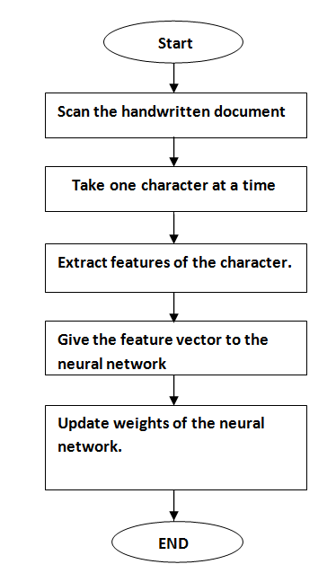
Optical Character Recognition
OCR system usually has two important steps :
Texts localization and recognition with the development of feature extraction methods, especially Convolutional Neural Networks (CNN) and Long-Short Term Memory (LSTM), there has been a significant progress in texts recognition

Slide 10
Flowchart
Doctors Capture Hardcopy of Medical Summary Using Camera.
Using NLP Keywords are Extracted from the Digital Image.
Using OCR, Digital Text is Extracted from the image.
A CSV File is Created and Stored With a List of Medical Parameters.
The List is Displayed as Output to the Doctors.

Slide 11
Requirements
Python
Natural Language Tool Kit Module
Tensor Flow Module

Slide 12
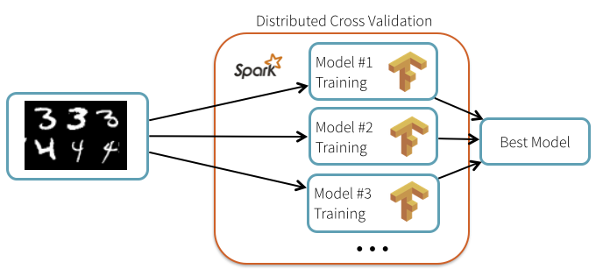
Tensor Flow
TensorFlow offers multiple levels of abstraction so you can choose the right one for your needs. Build and train models by using the high-level Keras API, which makes getting started with TensorFlow and machine learning easy.
If you need more flexibility, eager execution allows for immediate iteration and intuitive debugging. For large ML training tasks, use the Distribution Strategy API for distributed training on different hardware configurations without changing the model definition.

Slide 13
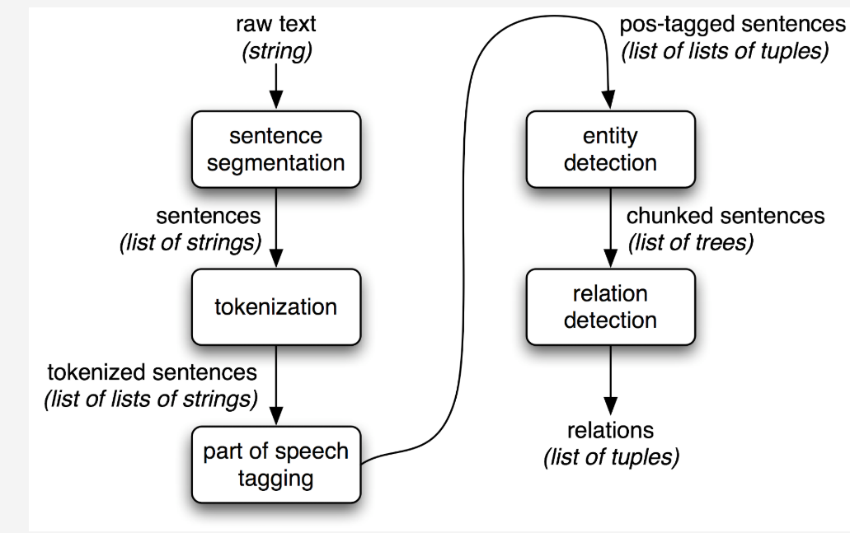
Natural Language Tool Kit
Natural Language Toolkit (NLTK) is a Python package to perform natural language processing (NLP). It was created mainly as a tool for learning NLP via a hands-on approach. It was not designed to be used in production.
The growth of unstructured data via social media, online reviews, blogs, and voice-based human-computer interaction are some reasons why NLP has become important in the late 2010s. NLTK is a useful toolkit for many of these NLP applications.
NLTK is composed of sub-packages and modules. A typical processing pipeline will call modules in sequence. Python data structures are passed from one module to another. Beyond the algorithms, NLTK gives quick access to many text corpora and datasets.

Slide 14
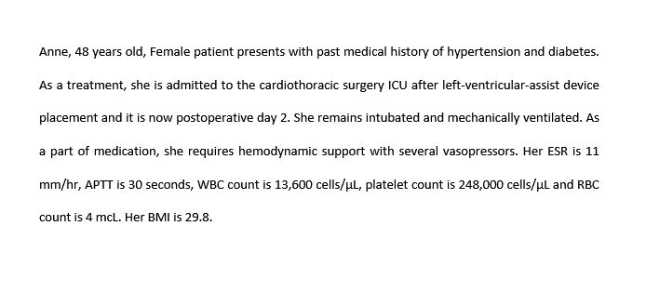
Input Data

Slide 15
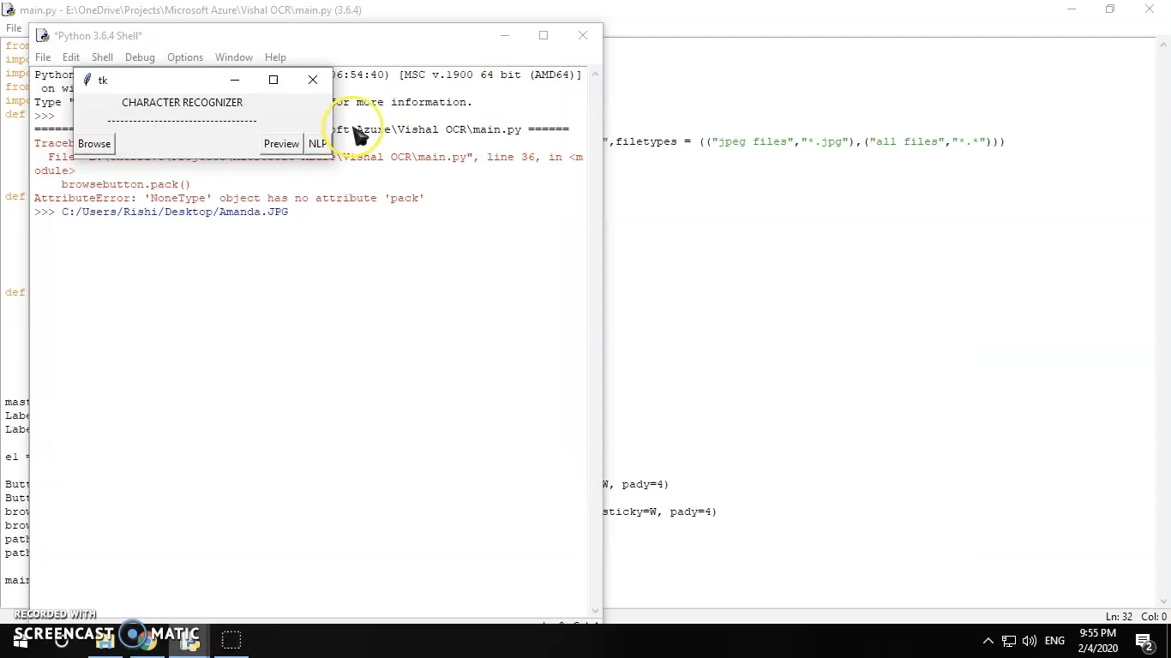
Demonstration Phase &Output

Slide 16
Code

Slide 17
Conclusion
To make the consumption of time less and to make the doctors work easier we came up with this project and by using natural language processing technique and optical character recognition we can easily extract the important things from the doctors prescription ,this smart analysis of medical reports will be useful in many ways to the doctor and for the treatment of the patients.

Slide 18
References
Reiner, B., 2010. Method of extracting real-time structured data and performing data analysis and decision support in medical reporting. U.S. Patent Application 12/591,979.
Savova, G.K., Masanz, J.J., Ogren, P.V., Zheng, J., Sohn, S., Kipper-Schuler, K.C. and Chute, C.G., 2010. Mayo clinical Text Analysis and Knowledge Extraction System (cTAKES): architecture, component evaluation and applications. Journal of the American Medical Informatics Association, 17(5), pp.507-513.
Wilcox, A.B. and Hripcsak, G., 2003. The role of domain knowledge in automating medical text report classification. Journal of the American Medical Informatics Association, 10(4), pp.330-338.

